Slide 1
Bayesian methods for non-clinical statisticians
Luwis Diya
TMEDS – Oncology, SDS
June 20, 2023

Slide 2
Agenda
1
Bayesian Principles
Prior
Likelihood
Posterior
Posterior predictive distribution
Bayesian Computation
Convergence
Comparison
Conclusion
2
3
4
5
6
7
8
9

Slide 3
Bayesian Principles
Bayesian Principles
Example: Collect evidence of an unknown treatment effect in a clinical trial
Frequentist analysis:
Point estimate and confidence intervals as summaries of size of treatment effect
What is this trial telling us about the treatment effect?
Bayesian analysis:
Before the trial: a priori opinion on the treatment effect
How should this trial change our opinion about the treatment effect?

Slide 4
Bayesian Principles
Motivation
Frequentist:
Bayesian
Question asked?
Question answered?
Question asked?

Slide 5
Bayesian Principles
Motivation
Frequentist:
Bayesian
Question asked?
Question answered?
Question answered?

Slide 6
Bayesian Principles
Motivation
Frequentist:
Bayesian
Motivation for adopting the Bayesian approach:
Natural and coherent way of thinking and/or learning about science
Question asked?
Question answered?
Question answered?

Slide 7
Bayesian Principles
Bayesian inference is a mechanism used to update the state of knowledge
Prior Information
Observed data
Total Information
+
=

Slide 8
Bayesian Principles
Bayesian inference is a mechanism used to update the state of knowledge
“LIKELIHOOD” data coming from the experiment
“PRIOR DISTRIBUTION” from previous studies, expert opinion, literature,…
Prior Information
Observed data
Total Information
+
=
“POSTERIOR DISTRIBUTION” combination of information collected before the experiment and what comes from the experiment data

Slide 9

Bayesian Principles
Bayesian inference is a mechanism used to update the state of knowledge
Let’s consider θ, the parameter of interest (ex: treatment effect)
Today’s “total information”/posterior is tomorrow’s prior information
$$\frac{p\left(θ\right)p\left(y | θ\right)}{p(y)}=p\left(θ | y\right)$$
Prior Information
Observed data
Total Information
+
=

Slide 10
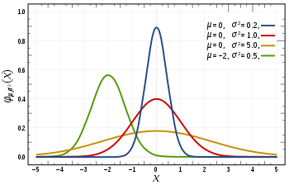
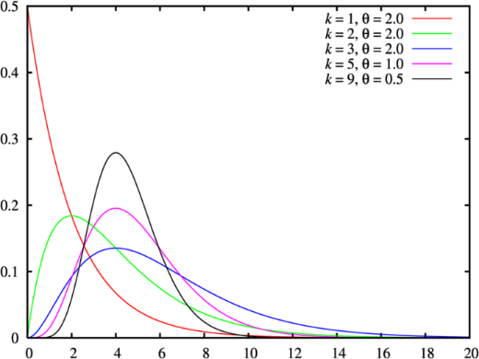
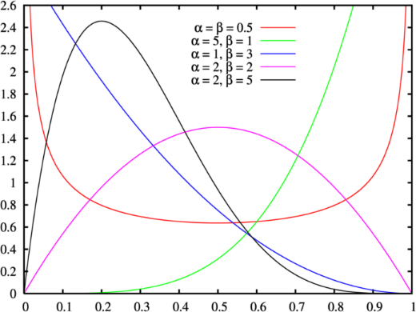
Prior
Prior ellucidation
Prior distribution of parameter θ : p(θ)
Distribution of θ before any data are observed
Reasonable opinion concerning the plausibility of different values of θ
Ideally based on all available evidence/knowledge (or belief)
Or deliberately select a non-informative prior (but should have a rationale)
Examples of prior distributions:
Normal distributions
Gamma distributions
Beta distributions
…

Slide 11
Prior
The impact
Can be very powerful
Part of the scientific process
Can advantageously replace data when well defined
Expert opinion
Comparable historical data
Likely to receive receive lots of questions about the prior
Design
Study
Model
Knowledge
Prior

Slide 12
Likelihood
Likelihood (assuming a model)
Conditional probability of the data given θ: p(y| θ)
Based solely on data

Slide 13
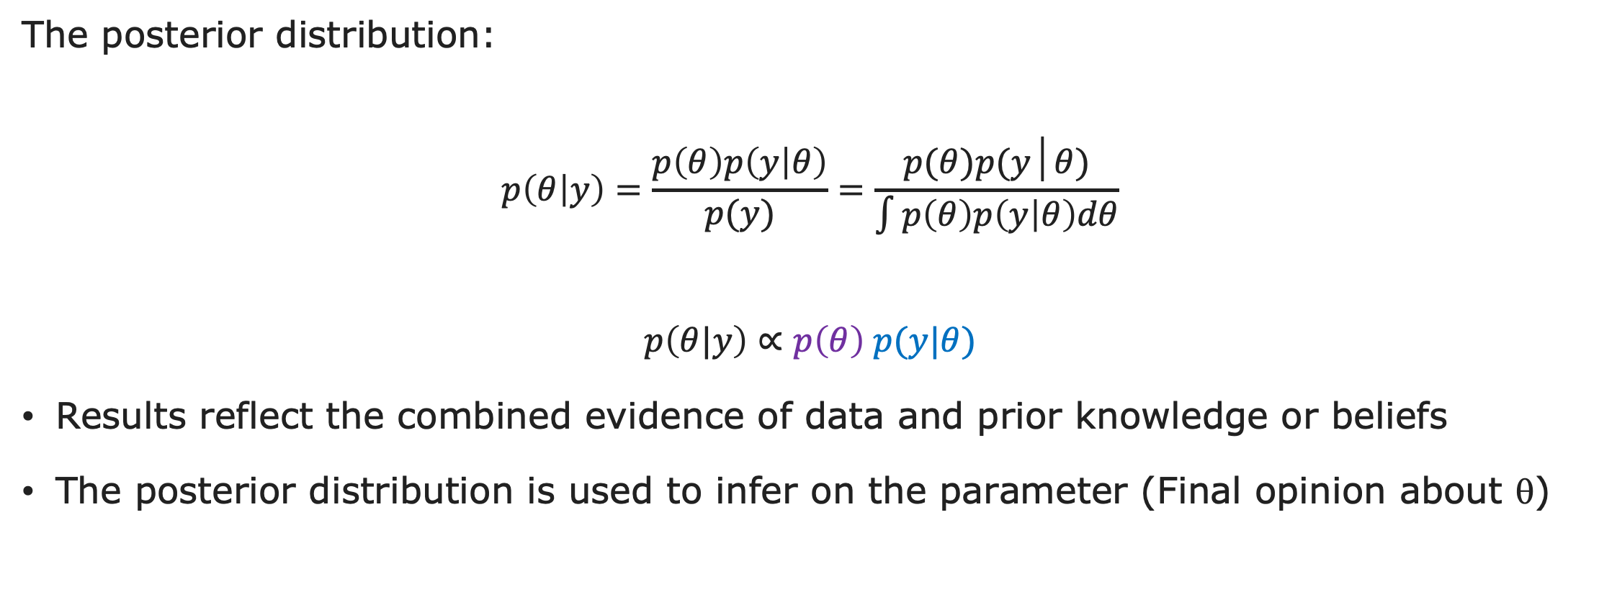
Posterior
Use the posterior distribution for decision making
The posterior distribution:
$$p\left(θ | y\right)=\frac{p\left(θ\right)p\left(y | θ\right)}{p(y)}=\frac{p(θ)p(y│θ)}{\int{p\left(θ\right)p\left(y | θ\right)dθ}}$$
$$p\left(θ|y\right)∝p\left(θ\right) p(y|θ)$$
Results reflect the combined evidence of data and prior knowledge or beliefs
The posterior distribution is used to infer on the parameter (Final opinion about θ)

Slide 14
Posterior
Use the posterior distribution for decision making
Uncertainty is described in terms of probability :
Posterior distribution
➔ Various questions can easily be answered
0.25
0.20
P(θ>5.4) = 0.41
0.15
0.10
0.05
0.00
-5
0
5
10
15
θ

Slide 15
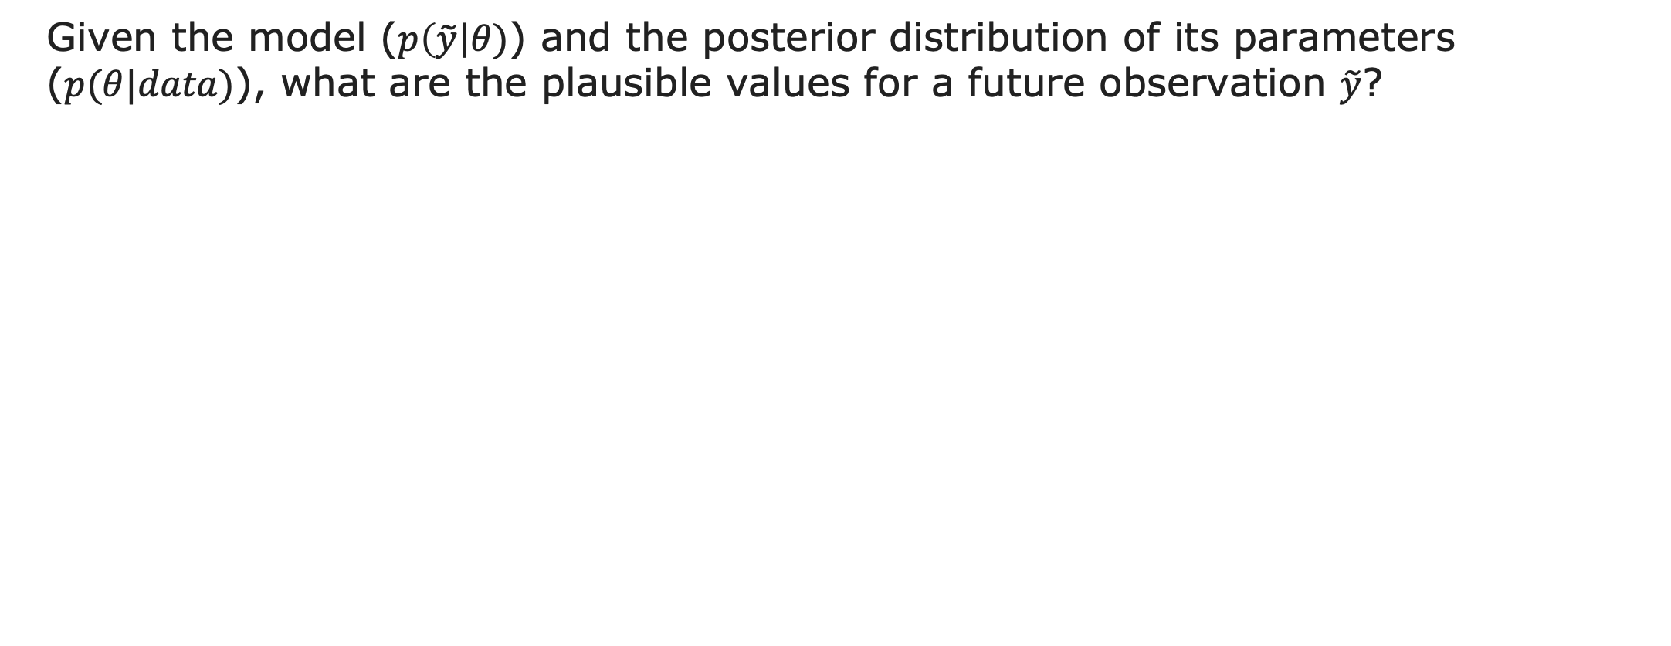
Posterior Predictive distribution
Posterior predictive distribution
Given the model ($p\left(\tilde{y}\right|θ)$) and the posterior distribution of its parameters ($p(θ|data)$), what are the plausible values for a future observation $\tilde{y}$?

Slide 16
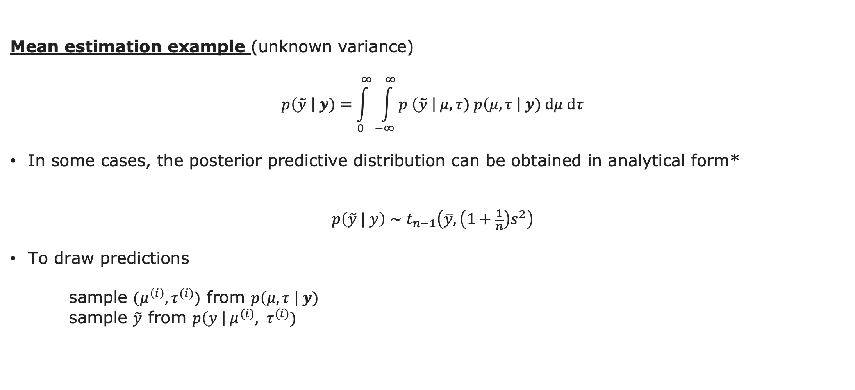
Posterior Predictive distribution
Example
Mean estimation example (unknown variance)
$$p\left(\tilde{y} \right| y)=\int_{0}^{∞}{\int_{−∞}^{∞}{p \left(\tilde{y} \right| μ, τ) p\left(μ, τ \right| y) dμ dτ}}$$
In some cases, the posterior predictive distribution can be obtained in analytical form*
$$p\left(\tilde{y} | y\right)∼t_{n−1}\left(\overline{y}, \left(1+\frac{1}{n}\right)s^{2}\right)$$
To draw predictions
sample $(μ^{\left(i\right)}, τ^{(i)})$ from $p\left(μ, τ \right| y)$ sample $\tilde{y}$ from $p\left(y \right| μ^{(i)}, τ^{(i)})$
*see: Gelman, A., Carlin, J. B., Stern, H. S. and Rubin, D. B. (2004). Bayesian Data Analysis. Chapman and Hall/CRC, 2nd ed. Chapter 3, p 77.

Slide 17
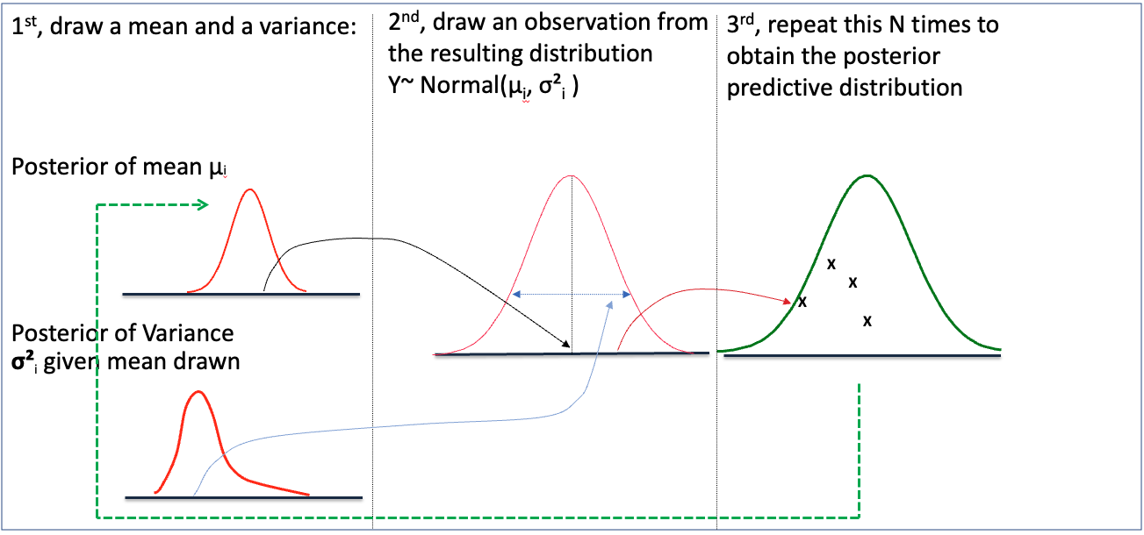
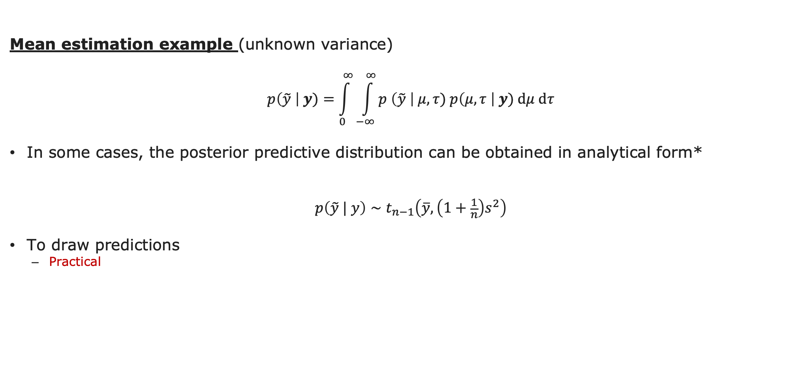
Posterior Predictive distribution
Example
Mean estimation example (unknown variance)
$$p\left(\tilde{y} \right| y)=\int_{0}^{∞}{\int_{−∞}^{∞}{p \left(\tilde{y} \right| μ, τ) p\left(μ, τ \right| y) dμ dτ}}$$
In some cases, the posterior predictive distribution can be obtained in analytical form*
$$p\left(\tilde{y} | y\right)∼t_{n−1}\left(\overline{y}, \left(1+\frac{1}{n}\right)s^{2}\right)$$
To draw predictions
Practical
*see: Gelman, A., Carlin, J. B., Stern, H. S. and Rubin, D. B. (2004). Bayesian Data Analysis. Chapman and Hall/CRC, 2nd ed. Chapter 3, p 77.

Slide 19

Posterior Predictive distribution
Difference between simulations and predictions
Simulations
the “new observations” are drawn from a distribution “centered” on estimated location and dispersion parameters (treated as “true values”).
Predictions
the uncertainty of parameter estimates (location and dispersion) is taken into account before drawing “new observations” from relevant distributions

Slide 20
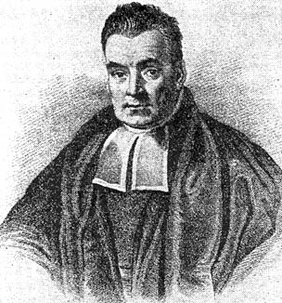
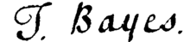
Bayesian Computation
Past limitations
1702 - 1761

Slide 21
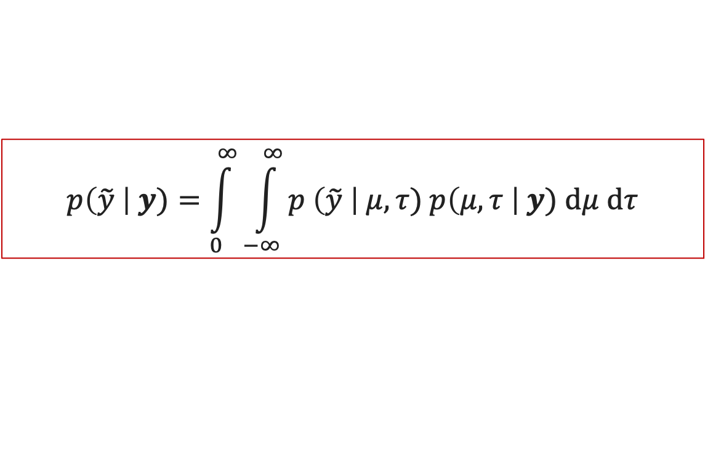
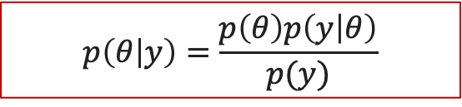
Bayesian Computation
Why now and not before?
In principle, there are two main equations to compute:
Analytical derivation:
Closed form solutions
Conjugacy
Sampling based approach:
Often, the mathematics become intractable, then, need to rely on computer simulation
Examples:
Markov Chain Monte Carlo [MCMC]: Gibbs sampling, Metropolis-Hastings algorithm,…
Hamiltonian Monte-Carlo [HMC ]: No U-turn Sampler (NUTS),….
No U-turn Sampler (NUTS)HMC …
Hamiltonian Monte-Carlo (HMC) HMC)
Approximations:
Integrated Nested Laplace Approximation [INLA]
$$p\left(\tilde{y} \right| y)=\int_{0}^{∞}{\int_{−∞}^{∞}{p \left(\tilde{y} \right| μ, τ) p\left(μ, τ \right| y) dμ dτ}}$$
$$p\left(θ | y\right)=\frac{p\left(θ\right)p\left(y | θ\right)}{p(y)}$$

Slide 22
Bayesian Computation
Tools
Two case studies will be used to illustrate the Bayesian approach
The Bayesian approach can be implemented using the following:
Stan via the R interface brms package
JAGS via the R interface rjags package
Nimble via the R interface nimble package
MLWin (Fit a frequentist model and generate WinBUGS code)
SAS Procedure MCMC
…

Slide 23
Bayesian Computation
Tools
Two case studies will be used to illustrate the Bayesian approach
The Bayesian approach can be implemented using the following:
Stan via the R interface brms package
JAGS via the R interface rjags package
Nimble via the R interface nimble package
MLWin (Fit a frequentist model and generate WinBUGS code)
SAS Procedure MCMC
…
Our focus:
Stan via the R interface brms package
https://paul-buerkner.github.io/brms/
JAGS via the R interface rjags package
https://cran.r-project.org/web/packages/rjags/index.html

Slide 24
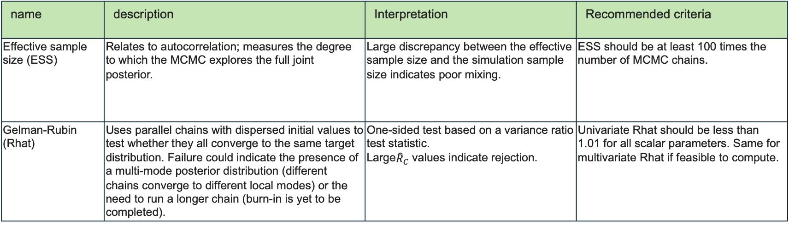
Convergence
Convergence diagnostics
No evidence of divergence
Not influenced by initial values
Fully explore the range of posterior distribution without getting stuck
Traceplots (visual check of the trajectory of the chain)
…
name | description | Interpretation | Recommended criteria
Effective sample size (ESS) | Relates to autocorrelation; measures the degree to which the MCMC explores the full joint posterior. | Large discrepancy between the effective sample size and the simulation sample size indicates poor mixing. | ESS should be at least 100 times the number of MCMC chains.
Gelman-Rubin (Rhat) | Uses parallel chains with dispersed initial values to test whether they all converge to the same target distribution. Failure could indicate the presence of a multi-mode posterior distribution (different chains converge to different local modes) or the need to run a longer chain (burn-in is yet to be completed). | One-sided test based on a variance ratio test statistic. Large${\hat{R}}_{C}$ values indicate rejection. | Univariate Rhat should be less than 1.01 for all scalar parameters. Same for multivariate Rhat if feasible to compute.
SAS System Documentation

Slide 25
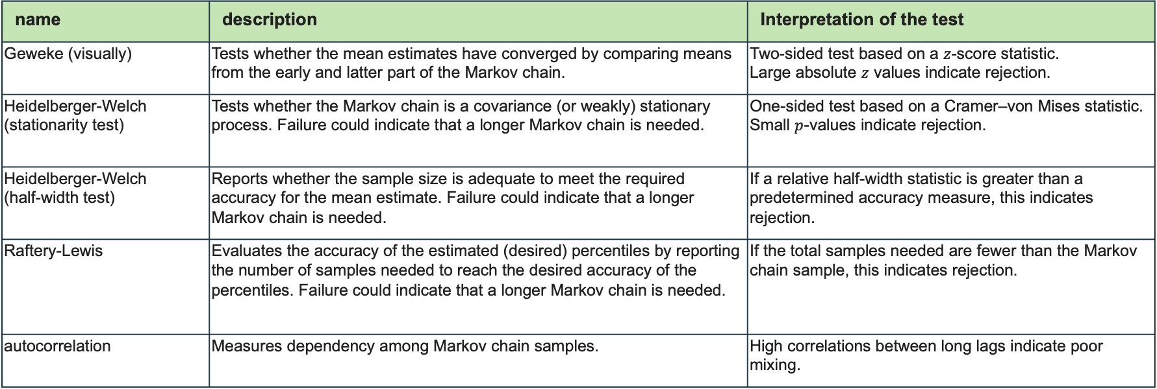
Convergence
Convergence diagnostics
name | description | Interpretation of the test
Geweke (visually) | Tests whether the mean estimates have converged by comparing means from the early and latter part of the Markov chain. | Two-sided test based on a $z$-score statistic. Large absolute $z$ values indicate rejection.
Heidelberger-Welch (stationarity test) | Tests whether the Markov chain is a covariance (or weakly) stationary process. Failure could indicate that a longer Markov chain is needed. | One-sided test based on a Cramer–von Mises statistic. Small $p$-values indicate rejection.
Heidelberger-Welch (half-width test) | Reports whether the sample size is adequate to meet the required accuracy for the mean estimate. Failure could indicate that a longer Markov chain is needed. | If a relative half-width statistic is greater than a predetermined accuracy measure, this indicates rejection.
Raftery-Lewis | Evaluates the accuracy of the estimated (desired) percentiles by reporting the number of samples needed to reach the desired accuracy of the percentiles. Failure could indicate that a longer Markov chain is needed. | If the total samples needed are fewer than the Markov chain sample, this indicates rejection.
autocorrelation | Measures dependency among Markov chain samples. | High correlations between long lags indicate poor mixing.
SAS System Documentation

Slide 26
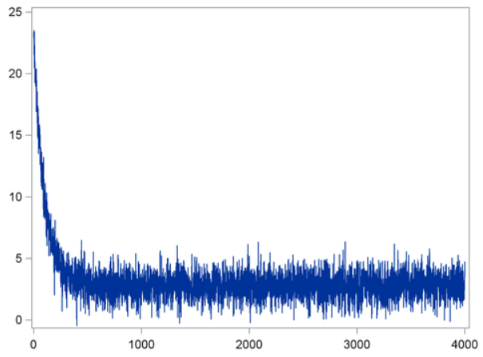
Convergence
Trace plot 1
Take some effort to reach the target density
Take a bigger burn-in period
Burn-in

Slide 27
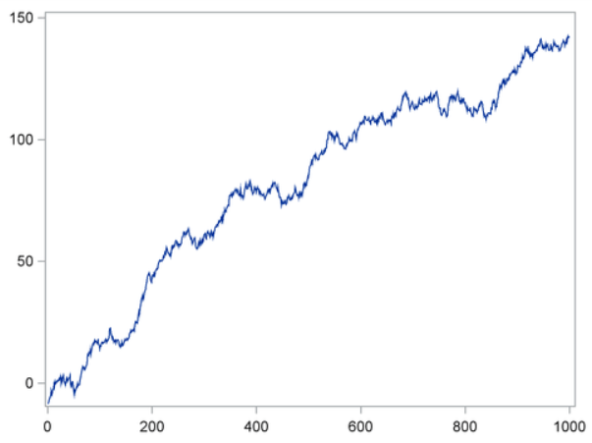
Convergence
Trace plot 2
Unstable chain

Slide 28
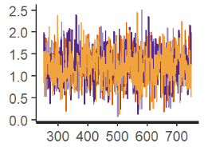
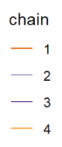
Convergence
Trace plot 3
Ideal situation!
Chains mixing well

Slide 29
Comparison
Bayesian vs Frequentist
Evidence used
Bayesian: all available (but relevant) information
Frequentist: Information from the current experiment
Inference
Bayesian: Bayesian: Prob of parameters given observed data
Frequentist: test of significance & getting p-values
Intervals
Bayesian: credible interval – 95% most plausible values (also HPD)
Frequentist: confidence interval (repeat the experiment….)
Status of parameters
Bayesian: Parameters are random variable (entire distribution)
Frequentist: Parameters are fixed (summaries: mean, SD,..)
Notes:
Frequentist: test of significance are performed by supposing that a hypothesis is true (the null hypothesis) and then computing the probability of observing a statistic at least as extreme as the one actually observed during hypothetical future repeated trials. (This is the P-value).
Frequentist : Confidence interval: “If we repeat the same experiment a large number of times, the confidence interval will contain the true value in 95% of the cases.”

Slide 30
Comparison
Bayesian vs Frequentist
For non-informative priors the Bayesian and Frequentist results are the “same” but the interpretation differ
Intepretation:
Coverage vs confidence
Assurance vs power
Posterior uncertainity vs standard error (uncertainity around a fixed value)
Bayesian approach can deal with bimodality
…
It can be confusing but note that “The Bayesian approach is a natural and coherent way of thinking and/or learning about science”
We are born Bayesians!
Most scientists we work with interprete the Frequenist results you give them in a Bayesian way!

Slide 31
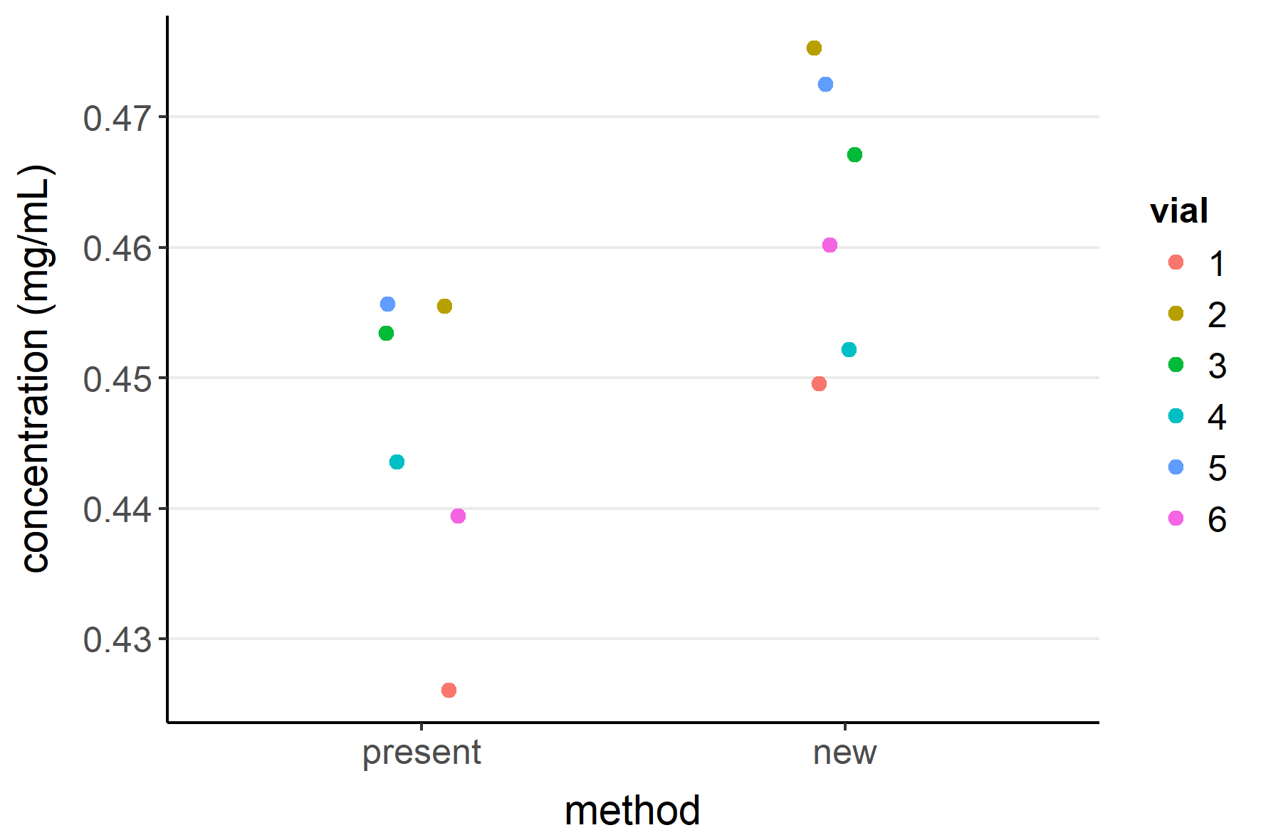
Comparison
Comparison of two analytical methods
6 vials are selected from a lot of drug product
Each vial is split into half, and each half is measured using a different analytical method (paired design)
The two methods are considered equivalent if the true difference in mean concentration is not greater than 0.02 mg/mL
PASS/FAIL vs continuous answer
Burdick, R. K., LeBlond, D. J., Pfahler, L. B., Quiroz, J., Sidor, L., Vukovinsky, K. & Zhang, L. (2017). Statistical Applications for Chemistry, Manufacturing and Controls (CMC) in the Pharmaceutical Industry. Springer.

Slide 32
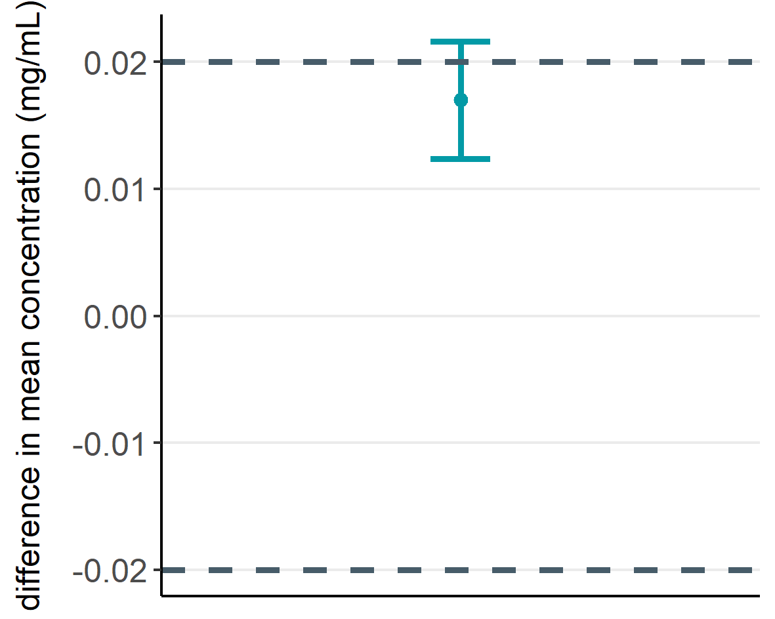
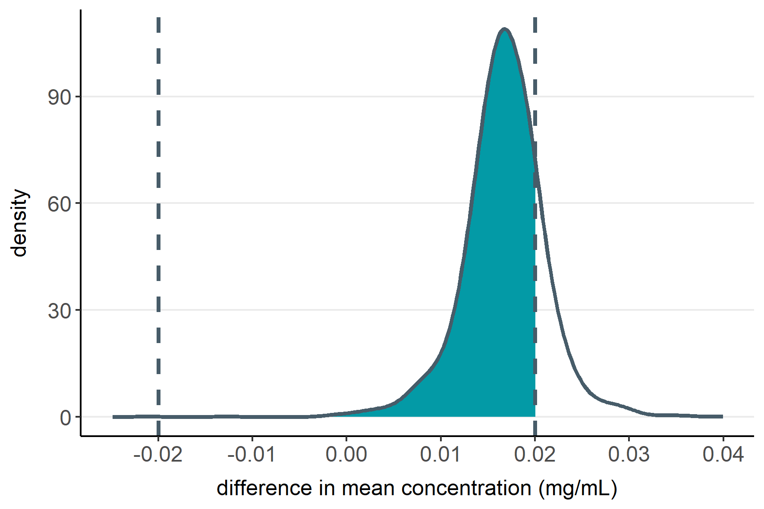

Comparison
Comparison of two analytical methods
Frequentist approach (TOST)
Bayesian approach
90% CI
$$\operatorname{Pr}\left(within margins\right)=0.83$$
Failed
Distribution and probability available

Slide 33
Conclusion
Next steps
My colleague, Will is going to go into more detailed information on Bayesian computation and convergence diagnostics
We will illustrate the Bayesian approach with two case studies
The idea is to show you that you don’t need a steep learning curve to grasph Bayesian analysis of data

Slide 34
Acknowledgments
I would like to thank:
Eli Lilly
Will Lanadu (my co-presenter)*
Yushi Liu*
Bristol Myers Squibb
Thomas Bradstreet*
Pharmalex
Pierre Lebrun
Daniz Akinc
Janseen R&D – SDS-TMEDS
Helena Geys
Jan Serroyen
Jeroen Tolboom
* Members of the NCB Bayesian Preclinical Animal Biomarker and Discovery Working Group

Slide 36
References
Burdick, R. K., LeBlond, D. J., Pfahler, L. B., Quiroz, J., Sidor, L., Vukovinsky, K. & Zhang, L. (2017). Statistical Applications for Chemistry, Manufacturing and Controls (CMC) in the Pharmaceutical Industry. Springer.
Bürkner, P.-C. (2017). Brms: An R package for Bayesian multilevel models using Stan. Journal of Statistical Software, 80(1). https://doi.org/10.18637/jss.v080.i01
Bürkner P (2018). “Advanced Bayesian Multilevel Modeling with the R Package brms.” The R Journal, 10(1), 395–411. doi:10.32614/RJ-2018-017.
Martyn Plummer (2003). JAGS: A Program for Analysis of Bayesian Graphical Models Using Gibbs Sampling, Proceedings of the 3rd International Workshop on Distributed Statistical Computing (DSC 2003), March 20–22, Vienna, Austria. ISSN 1609-395X.

